Slide 1
Simple 2D graph Plotting
Preethivardhan
160117737102
Hemanth
160117737095

Slide 2
Objectives:
The program takes mathematical data from the user as input and generates a mathematical graph on the Cartesian plane in DOS window.
This program simplifies the analysis of mathematical equations by judging their respective graphs.

Slide 3
Implementation:
Simple 2D graph plotting is a mini-project implemented on C++ platform to plot two dimensional graphs.
The main module used in the program is ‘graphics.h’ which include several functions to draw lines, circles, mouse applications,etc...
The program flow continues in a hierarchical manner and after selecting a choice a new DOS window is opened and the graph is drawn in that window using GUI.

Slide 4
Features:
Graph can be analysed easily by getting the coordinates of any point in the graph by moving the mouse to that respective point.
After choosing which graph to be drawn we also provided an option to choose between different colours with which to be drawn.
The axes are automatically constrained to the range of the graph.

Slide 5
Screen Shots

Slide 6
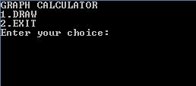
Main Menu

Slide 7
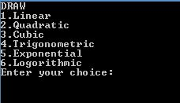
Types of Graphs

Slide 8
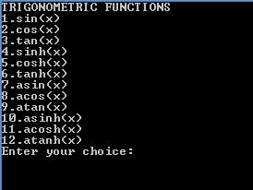

Slide 9
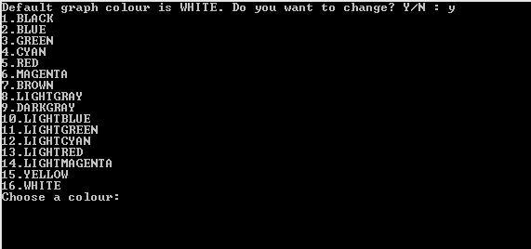
Colour Menu

Slide 10


Slide 11
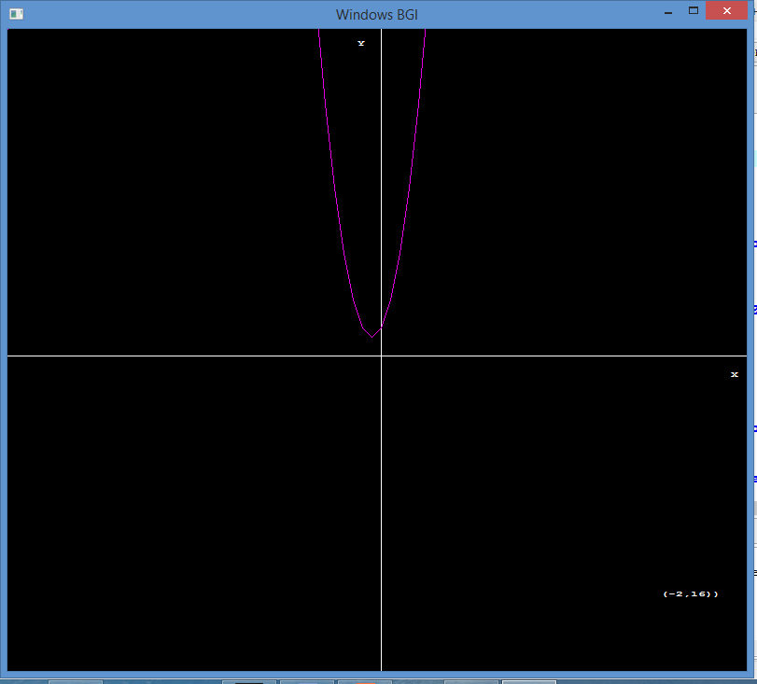

Slide 12
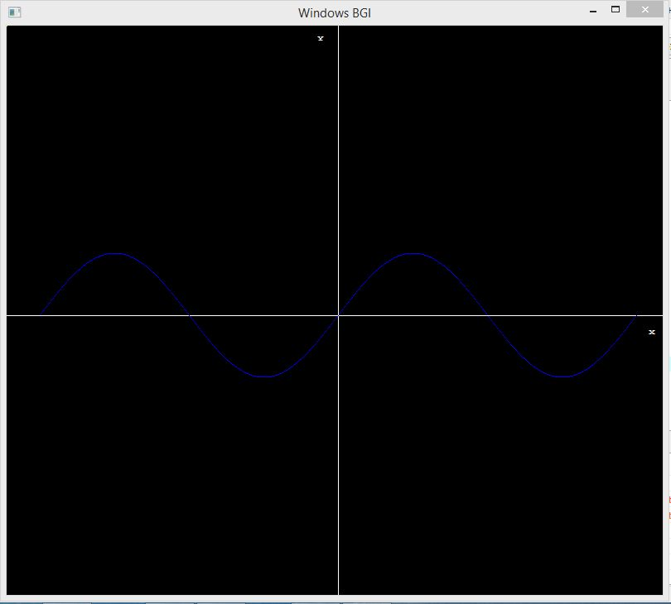

Slide 13
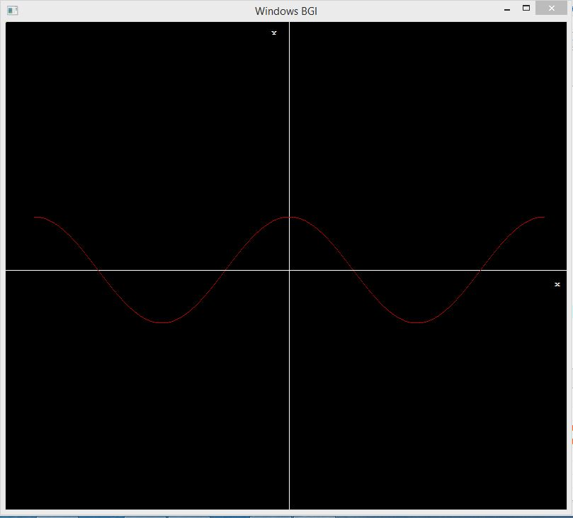

Slide 14
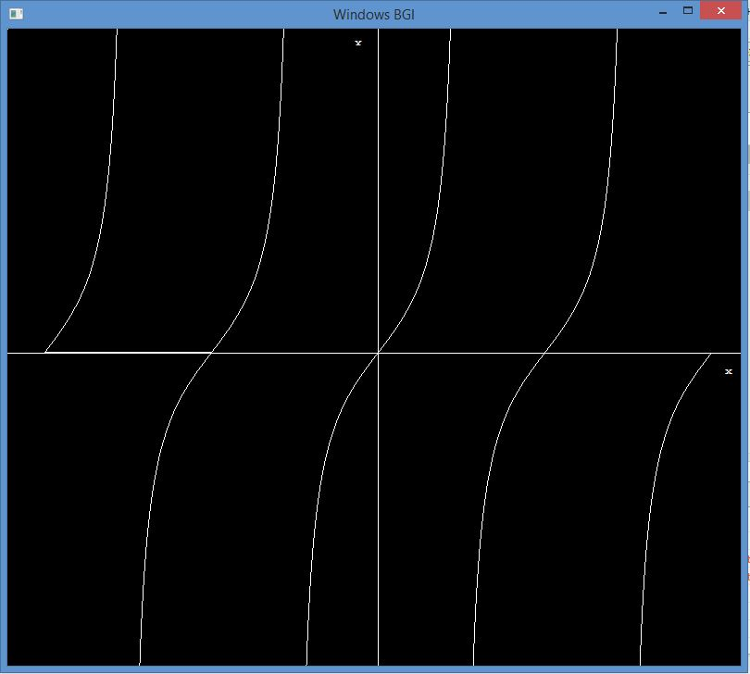

Slide 15
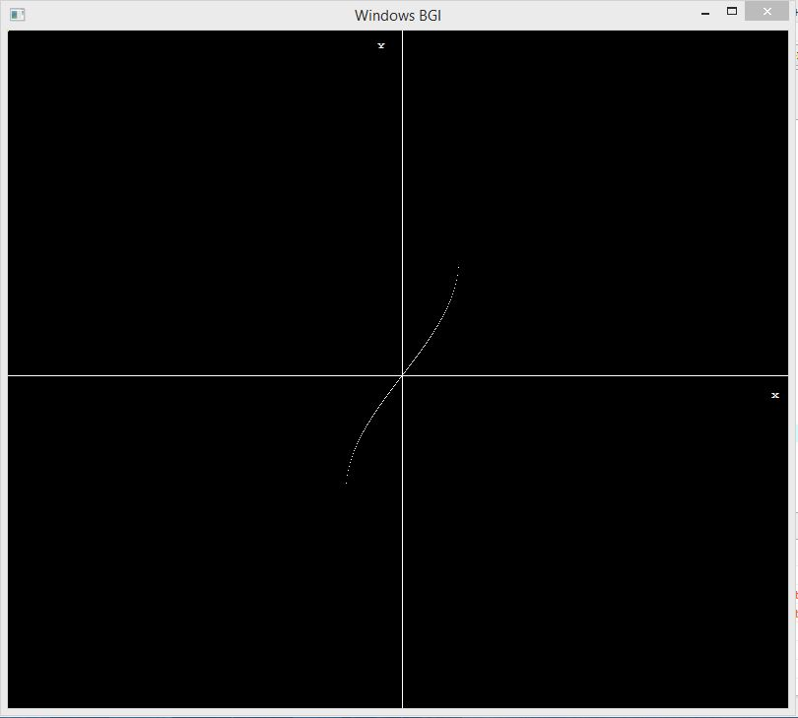

Slide 16
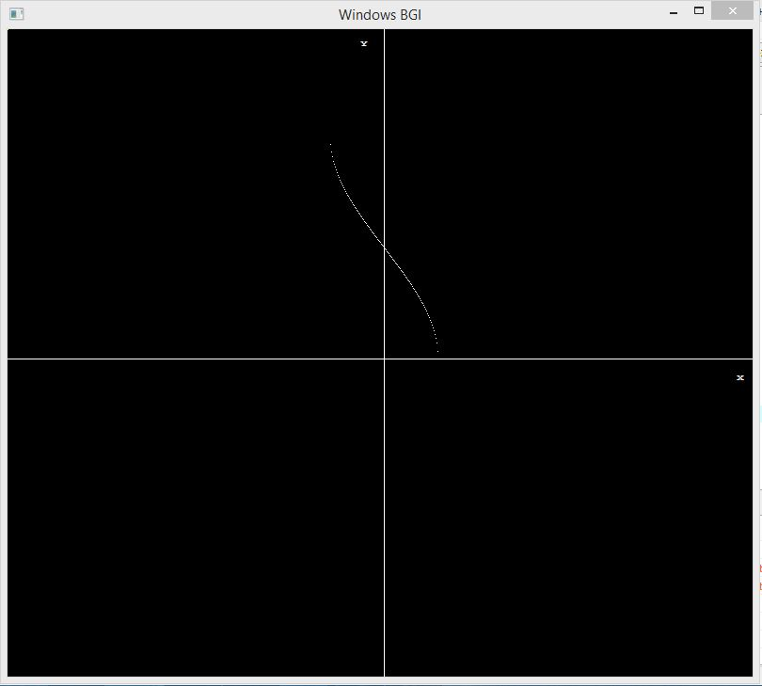

Slide 17
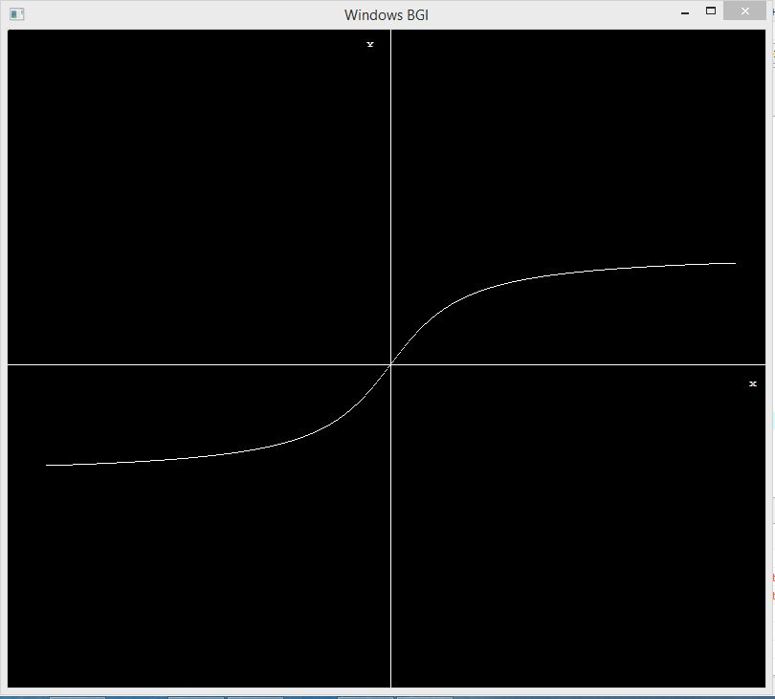

Slide 18
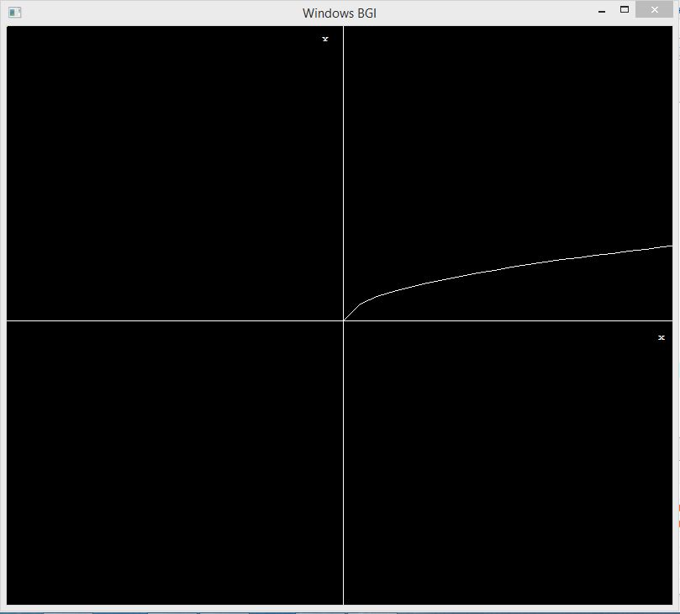

Slide 19
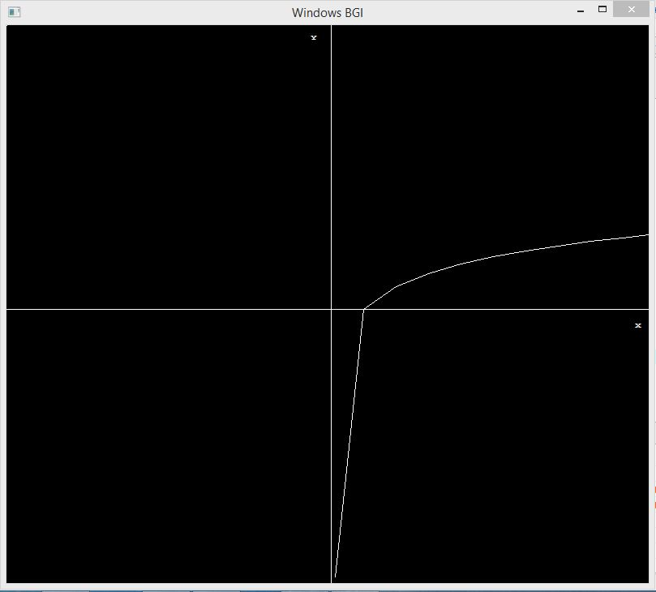

Slide 20
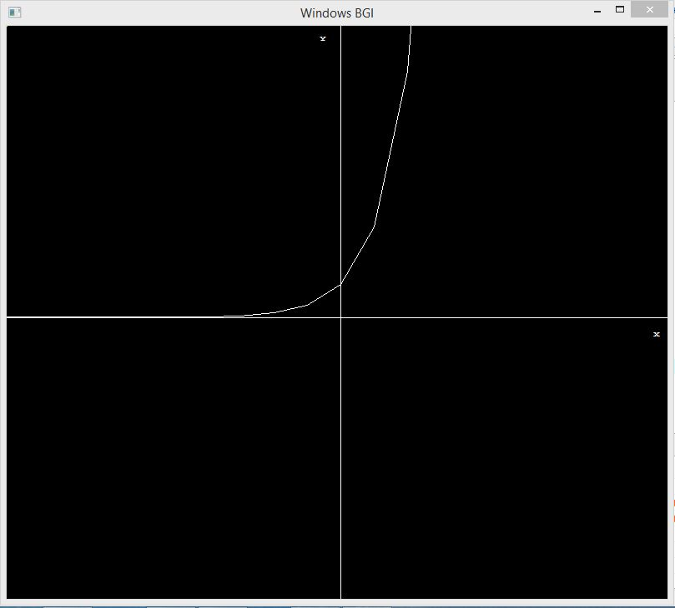

Slide 21
Thank You!

